Slide 1
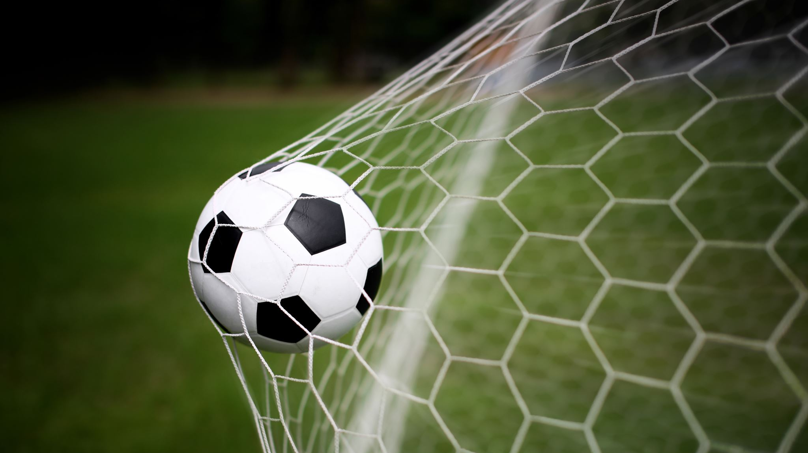
Soccer Player Tracking
GEOG 498G Project
Benjamin Kelly

Slide 2
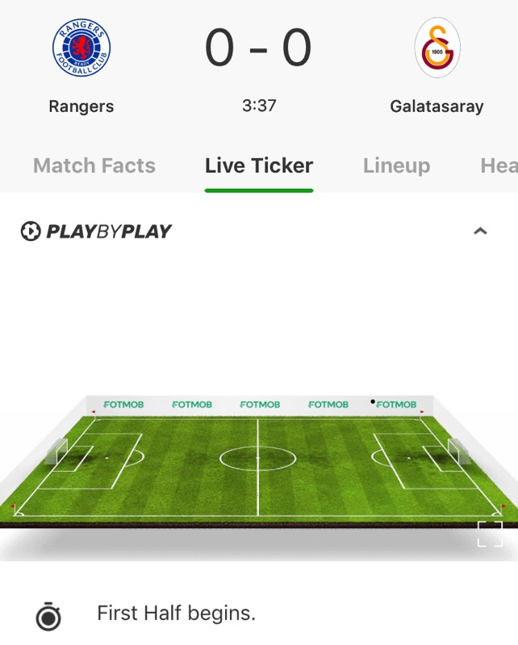
Problem to be addressed
Current sports apps have a poor system of displaying how games are playing in real time.
The image on the left is how most apps displays match info in real time.
Most games do not get play by play (This is speculation), because it requires a person to input the actions of the players

Slide 3
Goals of Project
Overall Goal:
Build an application to take in game video, and display players positions / movements
The a viewer should be able to watch a game from a birds-eye view perspective. (For soccer apps)
Tasks to be completed:
Write Code to identify players with in view of the camera, and began tracking them until out of view
Write code to identify the ball, and when a goal has been scored
Track player movements, and display in a birds-eye perspective.

Slide 4


Possible Road blocks
The OpenCV python is incredibly large, and it might take some time to get comfortable with it
Come Actually game footage might be hard to get because most profession Soccer footage is copyrighted

Slide 5
Elements
Python Libraries
Video / Training Data
Numpy
Python OpenCV
Real Game Footage
Video Captured from FIFA 20
Cleaning / Removing video that is zoomed in on one player, or is a replay

Slide 6
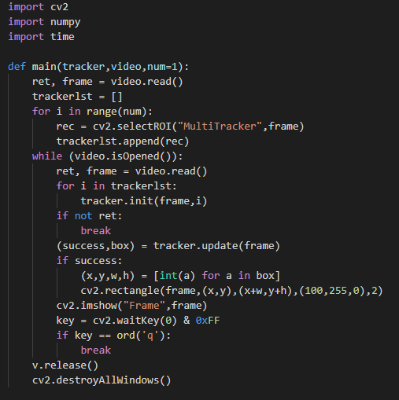
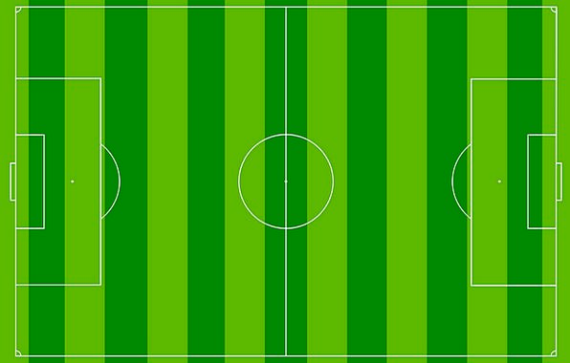
Example of Current Code

Slide 7
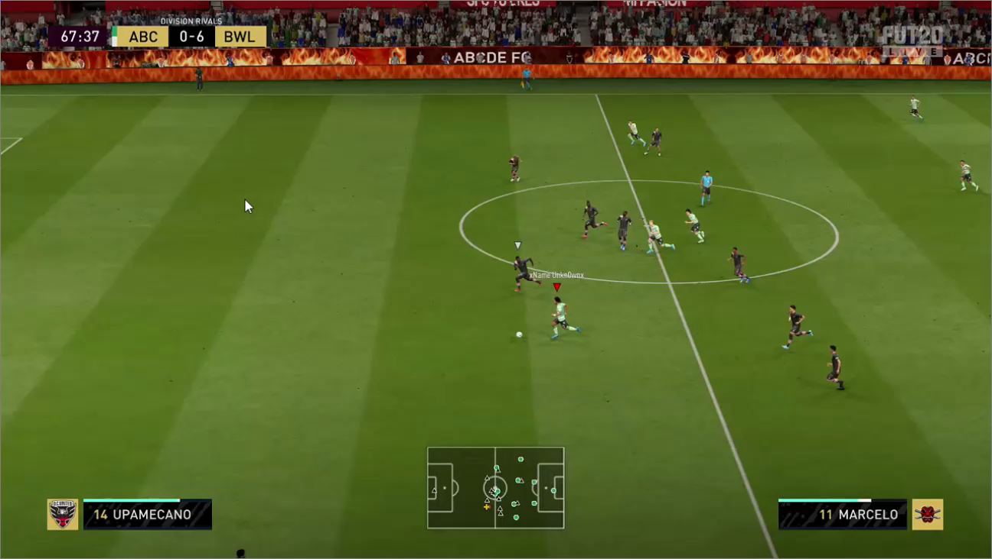
Current State of Project

